Slide 1
FLIGHT PRICE PREDICTION WEB-BASED PLATFORM . .
18-OCT-2025
1
Leveraging Generative AI for Real-time Airfare Forecasting
PRESENTED BY-
HARI R. (PRN21CS054)
S7 CSB
GUIDED BY-
SMT. SUZANNA CHARLY
ASSISTANT PROFESSOR
DEPT. OF COMPUTER SCIENCE

Slide 2
CONTENTS OF THIS TEMPLATE
18-OCT-2025
2
1 INTRODUCTION | 9 REAL-TIME FORECASTING MODULE
2 PROBLEM STATEMENT AND OVERVIEW | 10 MODEL TRAINING AND VALIDATION
3 LITERATURE REVIEW | 11 DEPLOYMENT SCENARIO
4 PROPOSED FRAMEWORK OVERVIEW | 12 USER INTERFACE AND REAL-TIME INSIGHTS
5 ARCHITECTURE OF PROPOSED SYSTEM | 13 RESULTS AND DISCUSSIONS
6 DATA PREPROCESSING | 14 CONCLUSION
7 GENERATIVE AI FRAMEWORK | 15 REFERENCES
8 DEEP LEARNING ARCHITECTURES | 16 END PAGE ( Thank You)

Slide 3
INTRODUCTION
18-OCT-2025
3
Airfare Complexity: Flight pricing is influenced by demand, routes, fuel prices, and time factors. Predicting prices is challenging due to frequent fluctuations.
Importance of Forecasting: Real-time predictions provide valuable insights for airlines, agents, and consumers to optimize pricing and make informed decisions.
Role of GAI: Generative AI models, integrated with deep learning, can capture intricate data patterns and forecast prices with greater precision compared to traditional methods.

Slide 4

PROBLEM STATEMENT & OBJECTIVE
18-OCT-2025
4
Challenges with Traditional Models: Traditional airfare forecasting models often fail due to their inability to handle the dynamic market variables like fuel costs and passenger loads.
Need for Real-Time Forecasting: Rapid shifts in demand and external factors necessitate a solution that continuously updates predictions as new data streams in.
Objective: Develop a real-time, generative AI-based platform capable of forecasting airfare with high accuracy by leveraging historical data and deep learning.

Slide 5

LITERATURE REVIEW
18-OCT-2025
5
N. Alapati et al., “Prediction of Flight-fare using machine learning” This study focuses on machine learning models for flight-fare prediction. The paper highlights the effectiveness of ML algorithms in capturing dynamic factors affecting airfare, such as demand and market conditions, to improve fare prediction accuracy.
C. K. Gupta et al., “Dynamic Flight Price Prediction Using Machine Learning Algorithms” This paper presents a dynamic flight price prediction model that integrates multiple machine learning algorithms to handle rapidly changing factors like route popularity and seasonal trends. It emphasizes the adaptability of the model to real-time pricing data.
R. Kashef, “Forecasting The Price of the Flight Tickets using A Novel Hybrid Learning Model” This paper proposes a hybrid learning model, combining traditional statistical methods and machine learning to enhance prediction accuracy. The hybrid approach addresses the limitations of each method, leading to improved airfare forecasting.

Slide 6


PROPOSED FRAMEWORK OVERVIEW
18-OCT-2025
6
1
Combination of GAN and Deep Learning: The framework integrates Generative Adversarial Networks (GAN) for generating complex airfare scenarios and LSTM-based RNNs for time-series forecasting.
2
Web Engineering: Real-time updates are possible by using a web-based platform that fetches live data streams and recalibrates predictions instantly.
3
Core Modules: Includes data preprocessing, generative AI, deep learning, and real-time forecasting as the key functional components.

Slide 7
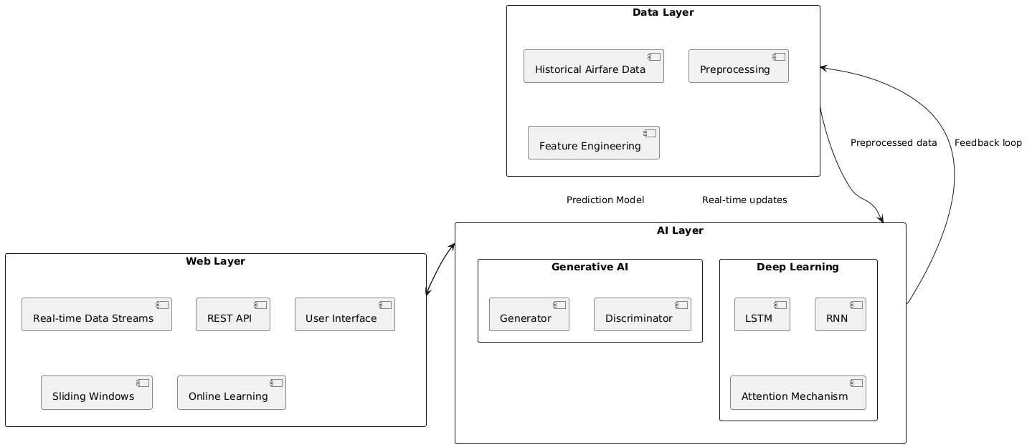
ARCHITECTURE OF THE PROPOSED SYSTEM
18-OCT-2025
7
System Overview: The architecture includes three key layers: the data layer (preprocessing historical data), the AI layer (GAN and RNN models), and the web layer (real-time interaction with live data).

Slide 8
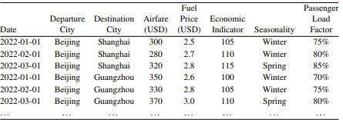
DATA PREPROCESSING
18-OCT-2025
8
Data Collection: Historical airfare data (route details, temporal patterns, fuel prices, etc.) is collected from multiple sources.
Cleaning and Outliers: Techniques like Z-score and interquartile range (IQR) are applied to remove outliers and ensure data consistency​.
Feature Engineering: Important features like seasonality, economic indicators, and passenger load factors are extracted to improve model accuracy​.
Table 1 (Historical Airfare Dataset)

Slide 9
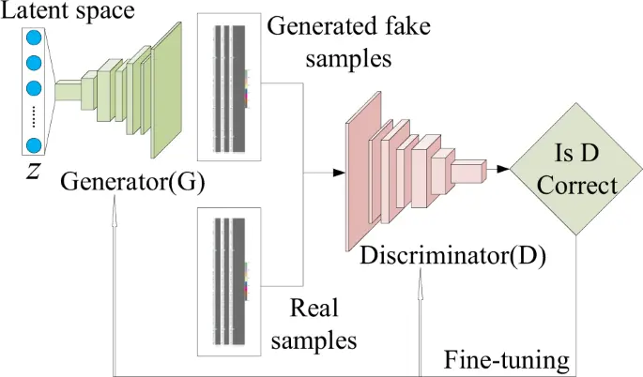
GENERATIVE AI FRAMEWORK
18-OCT-2025
9
Generative Adversarial Networks (GANs): The GAN framework consists of two models—Generator and Discriminator. The generator predicts future airfare prices by learning complex data patterns, while the discriminator evaluates the accuracy of those predictions​.
Adversarial Training: The two models compete in a loop, improving each other. The generator attempts to produce realistic future price data, and the discriminator works to distinguish between real and generated data. This process refines the predictions​.
Figure 1: (GAN Neural Network) Illustrates the architecture and mechanism of the GAN.

Slide 10

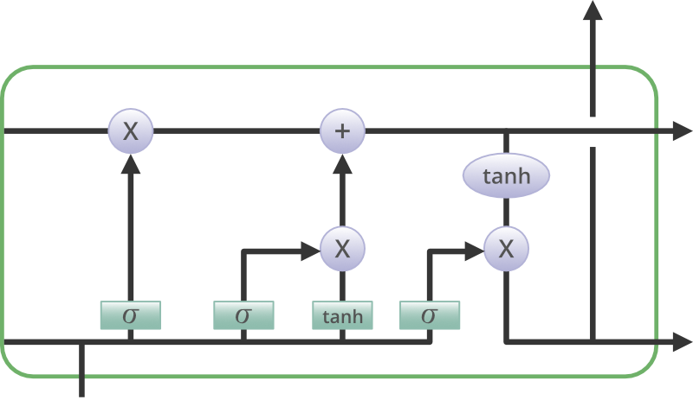
DEEP LEARNING ARCHITECTURES
18-OCT-2025
10
Recurrent Neural Networks (RNNs): RNNs, specifically LSTMs (Long Short-Term Memory networks), are used to capture sequential dependencies in time-series airfare data. They track patterns over time and improve predictions based on recent trends​.
Long Short-Term Memory (LSTM): LSTM units in the model help retain long-term dependencies in the data, which traditional RNNs struggle with. This is essential for understanding airfare fluctuations that depend on seasonal or route-based patterns​.
Figure 2 Explain how LSTMs process the sequential airfare data and capture relevant time-dependent information​.

Slide 11
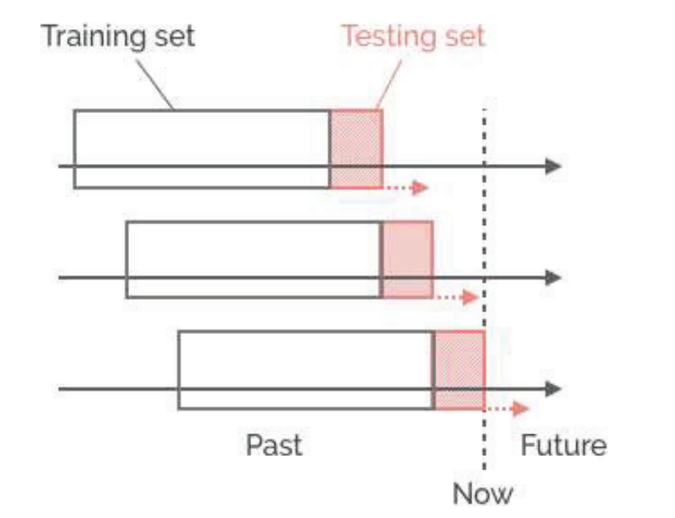
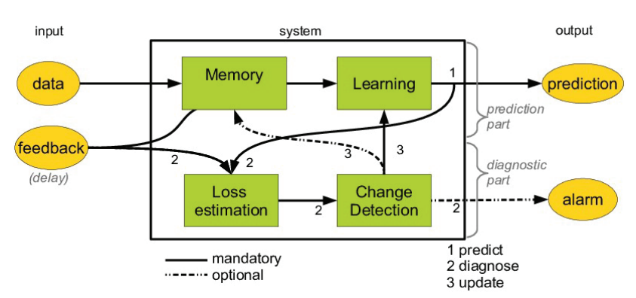
REAL-TIME FORECASTING MODULE
18-OCT-2025
11
Sliding Windows Technique: The sliding window approach is used to focus on the most recent data for training the model. This allows it to continuously adapt to current market conditions​.
Online Learning: Online learning ensures that the model is updated with each new piece of data, allowing real-time recalibration of airfare predictions as live data streams in​.
Figure 4 (Online Learning Methodology)
Explains how the model is continuously updated with fresh data​.
Figure 3 (Sliding Windows)

Slide 12
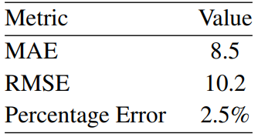
MODEL TRAINING AND VALIDATION
18-OCT-2025
12
Training Process
The model is trained on historical data using advanced optimization techniques. Cross-validation is used to ensure that the model can generalize to unseen data
Hyperparameter Tuning
This involves fine-tuning the model’s parameters (e.g., learning rate, window size) to optimize its predictive performance across different market conditions.
Performance Metrics
The model is evaluated using metrics like Mean Absolute Error (MAE), Root Mean Squared Error (RMSE), and Percentage Error to assess its accuracy.
Table 2 (Evaluation Metrics)
MAE MEAN ABSOLUTE ERROR
RMSE ROOT MEAN SQUARE ERROR

Slide 13
SCENARIO: REAL-TIME FLIGHT PRICE PREDICTION SYSTEM DEPLOYMENT
18-OCT-2025
13
Step 1
Step 2
Step 3
Deployment Prototype: The real-time prediction system is deployed for a fictional airline (e.g., SkyVision) in collaboration with a tech firm (DataFly Innovations). This showcases how the model is applied in a real-world setting.
Data Handling: The system integrates real-time data streams, automatically updating predictions as new airfare data becomes available from various sources.
Steps to Implementation: The key steps involved in deploying the model include preprocessing the data, setting up the GAN and LSTM architectures, and configuring the system for real-time operations using web APIs​.

Slide 14
USER INTERFACE AND REAL-TIME INSIGHTS
18-OCT-2025
14
User Interface Design
A
B
Input Scenarios
Steps to Implementation: The key steps involved in deploying the model include preprocessing the data, setting up the GAN and LSTM architectures, and configuring the system for real-time operations using web APIs.
Users can input various scenarios (e.g., changing fuel prices, economic indicators) to view predicted price changes across different routes and time frames​.
USER
C
Conitnous Monitoring
The system continuously monitors the accuracy of predictions and adjusts based on new data. Feedback loops allow the model to learn from real-world outcomes and improve​

Slide 15
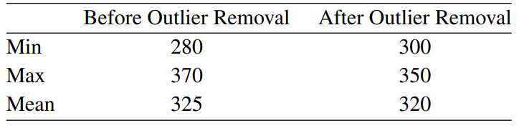
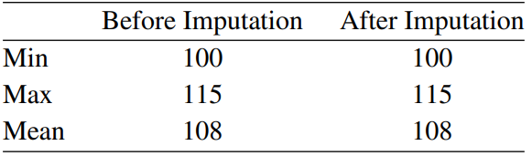
RESULTS AND DISCUSSIONS
18-OCT-2025
15
Handling Outliers and Missing Values: The sliding window approach is used to focus on the most recent data for training the model. This allows it to continuously adapt to current market conditions​.
Performance of the Prediction Model: The model demonstrated high accuracy in predicting airfare, with low mean absolute error and percentage error​.
RESULTS
Table 3 (Outliers Removal) illustrates how this method helps focus on the most recent trends for better prediction​.
Table 4 (Imputation) and Table 5 (Feature Engineering)
Explains how the model is continuously updated with fresh data​.

Slide 16
CONCLUSION
18-OCT-2025
16
Summary of Key Findings: The integration of GANs and LSTMs in a web-based framework provides a powerful solution for real-time flight price forecasting, outperforming traditional methods​.
Implications for the Aviation Industry: The ability to predict airfare accurately in real-time can help airlines optimize their pricing strategies and respond faster to market changes.
Future Research: The model could be expanded by incorporating additional factors (e.g., economic indicators, weather data) and improving the real-time feedback system​.

Slide 17
REFERENCES
18-OCT-2025
17
N. Alapati et al., “Prediction of Flight-fare using machine learning,” in 2022 International Conference on Fourth Industrial Revolution Based Technology and Practices (ICFIRTP), Aug. 2022, pp. 134–138. doi:10.1109/ICFIRTP56122.2022.10059429.
C. K. Gupta, O. Nath Kushwaha, A. S. Yadav, and V. Kumar, “Dynamic Flight Price Prediction Using Machine Learning Algorithms,” in 2022 4th International Conference on Advances in Computing, Communication Control and Networking (ICAC3N), Sep. 2022, pp. 201–205. doi: 10.1109/ICAC3N56670.2022.10074448.
R. Kashef, “Forecasting The Price of the Flight Tickets using A Novel Hybrid Learning model,” in 2023 IEEE World AI IoT Congress (AIIoT), Jun. 2023, pp. 305–310. doi: 10.1109/AIIoT58121.2023.10174373.

Slide 18

Thanks!
18-OCT-2025
18

